Slide 1
POWER BI
WEEK 1 TASK
NAME : SOWMIYA R
DEPARTMENT : B.Sc(DS & AI)
ROLL NO : E25DA041

Slide 2
Introduction
This report summarizes the activities, learnings, and deliverables completed during Week 1 of the Power BI internship. The focus of this week was to understand the problem statement, select a suitable dataset, and plan the data strategy for building an interactive Power BI report.
Objectives of Week 1
Understand the overall goal of the Power BI project.
Select a publicly available dataset suitable for analysis.
Perform initial data exploration and identify key fields.
Plan the data model (tables, relationships, primary/foreign keys).
Document the process with screenshots and explanations.
3. Dataset Selection
Dataset Name: [e.g., “Sales Data”, “HR Attrition”, “Credit Card Transactions”]
Source: [Kaggle / GitHub / Government Portal / Company-provided]
Why this dataset?:
Contains multiple dimensions (e.g., time, product, customer).
Suitable for building KPIs and interactive visuals.
Clean enough for initial modeling, but still needs transformation.github+1

Slide 3
4. Data Strategy and Planning
Data Cleaning Plan
Remove duplicates and nulls in key columns.
Standardize date formats.
Create calculated columns (e.g., Month, Quarter, Year).
Handle outliers if present
5. Tasks Completed
Installed and set up Power BI Desktop.
Imported the selected dataset into Power BI.
Explored data using Power Query Editor.
Performed basic cleaning (removed blanks, fixed data types).
Created a simple data model with 2–3 tables and relationships.
Documented each step with screenshots.

Slide 4
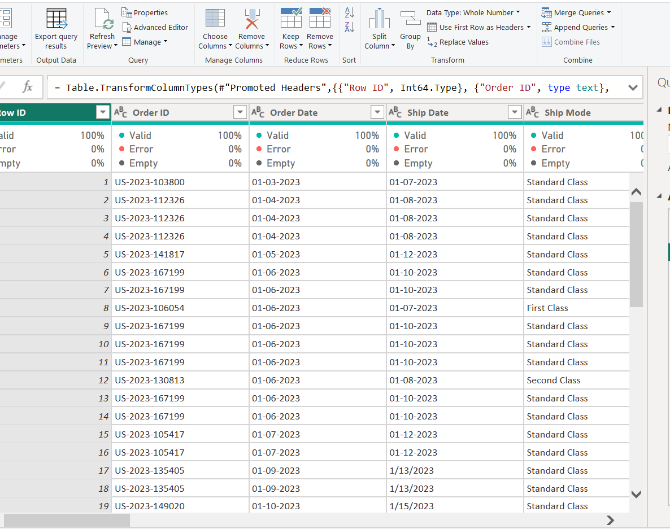
SCREENSHOT 1 :
Title:
Data Import into Power Query Editor
The Superstore dataset was successfully imported into Power Query Editor for data cleaning and transformation.

Slide 5
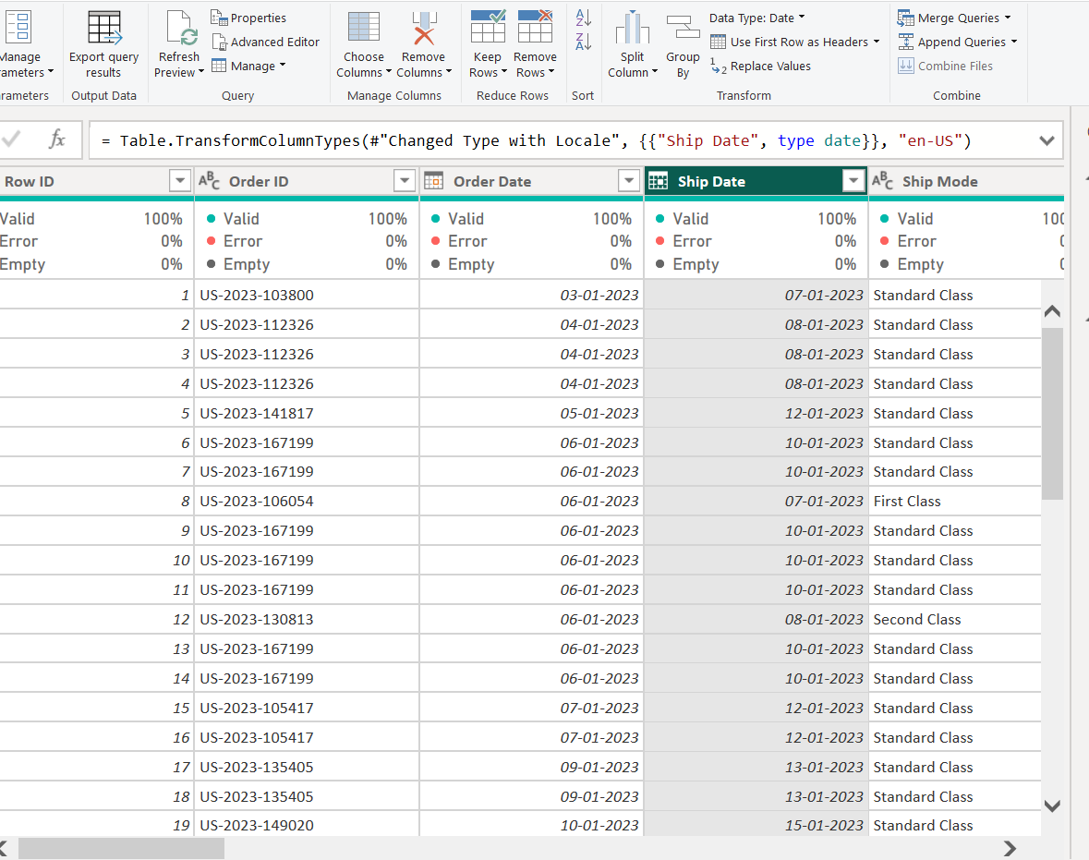
SCREENSHOT 2 :
Title:
Text Cleaning and Data Transformation
The Superstore dataset was successfully imported into Power Query Editor. The dataset contains multiple columns such as Row ID, Order ID, Order Date, Ship Date, and Ship Mode. The imported records are displayed in rows for further data cleaning and transformation.

Slide 6
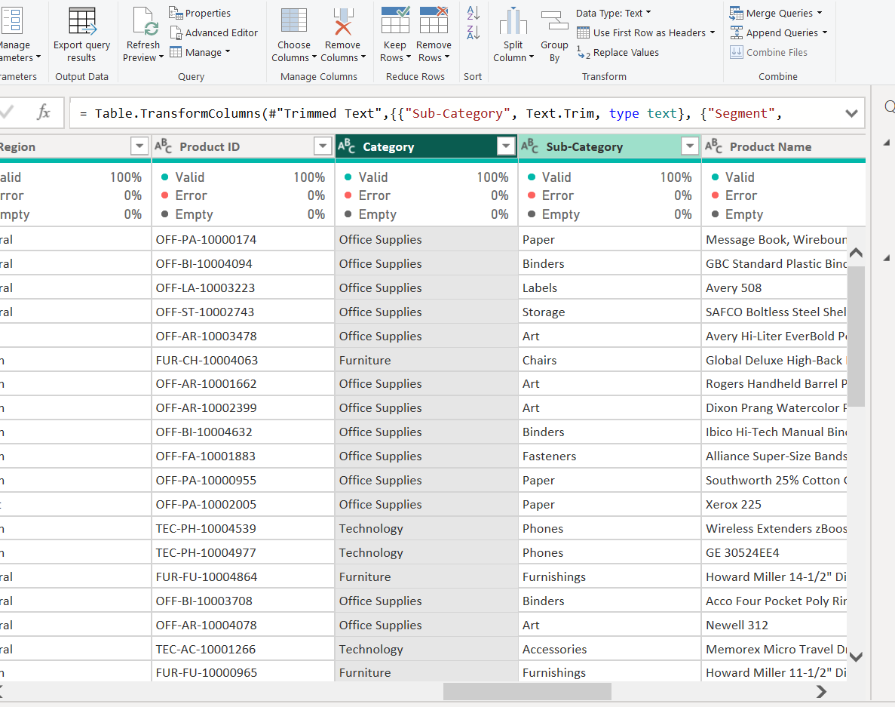
SCREENSHOT 3 :
Topic:
Text Cleaning and Data Transformation
The text columns in the Superstore dataset were cleaned using Power Query. Text trimming was applied to remove unnecessary spaces from fields such as Sub-Category and Segment. The cleaned data was then checked to ensure that the values were properly formatted.

Slide 7
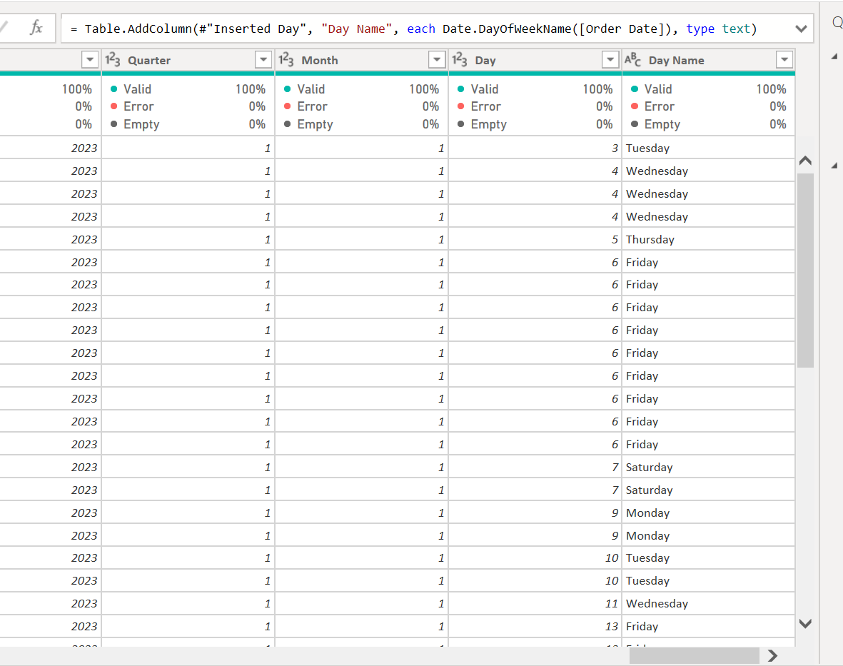
SCREENSHOT 4 :
Title:
Order Date Transformation
The Order Date column was separated into individual date components such as Year, Quarter, Month, Day, and Day of Week using Power Query. This transformation makes the date information easier to analyze and use for further data analysis.

Slide 8
CONCLUSION :
The Superstore dataset was successfully imported and prepared using Power Query. Data cleaning and date transformations were performed to improve data quality and make the dataset suitable for further analysis. The transformed data is now ready for analysis and visualization in Power BI.

